Slide 1

ADVANCED ALGORITHMS

Slide 2

ADVANCED ALGORITHMS
BASICS OF COMPLEXITY

Slide 3
ADVANCED ALGORITHMS
Worst case: C_{worst}(n) – maximum over inputs of size n
Best case: C_{best}(n) – minimum over inputs of size n
Average case: C_{avg}(n) – “average” over inputs of size n
Number of times the basic operation executes on typical input
NOT necessarily average of worst and best case
BASICS OF COMPLEXITY

Slide 4
ADVANCED ALGORITHMS
BASICS OF COMPLEXITY
Algorithm UniqueElements(A[0---n-1])
for(i = 0 ; I < n – 1 ; i++)
for( j = i + 1 ; j < n ; j++)
if(A[i] == A[j])
return false;
end for
end for
return true
Basic Operation
C_{Best}(n) = 1 ∈ Ω(1)
C_{Worst}(n):
C_{Worst}(n) = (n-1) + (n-2) + … +1 = n(n-1)/2 ∈ O(n²)
i | 0 | 1 | 2 | .. | n-2
j | n-1 | n-2 | n-3 | .. | 1

Slide 5
ADVANCED ALGORITHMS
BASICS OF COMPLEXITY
Algorithm Binarybits(n)
count ← 1
while( n > 1) do
count <- count + 1
n <- n/2
end while
return count
Basic Operation : increment and division
Let n=2^{k}
N : 2^{k} 2^{k-1} 2^{k-2} …… 2^{k-k}
The loop gets executed k times
n=2^{k}
k=log₂n
C(n)=log₂n ∈ O(log₂n)

Slide 6
ADVANCED ALGORITHMS
BASICS OF COMPLEXITY
Algorithm BinarybitsRec(n)
if n==1
return 1
else
return BinarybitsRec(floor(n/2))+1
Recurrence Relation: C(n) = C(n/2)+1 and C(1)=0
C(n)= C(n/2) + 1
= C(n/4) +1 + 1
= C(n/8) +3
= C(n/2^{k}) +k
Let n=2^{k}
C(n)= 0 + k
k=log₂n
C(n)=log₂n ∈ O(log₂n)

Slide 7
ADVANCED ALGORITHMS
BASICS OF COMPLEXITY
Algorithm Fib(n)
F[0] <- 0
F[1] <- 1
for i <- 2 to n do
F[i] <- F[i-1] + F[i-2]
end for
return F[n]
Basic Operation : Addition
C(n)= n-1 ∈ O(n)

Slide 8
ADVANCED ALGORITHMS
BASICS OF COMPLEXITY
Algorithm FibRec(n)
if n<= 1
return n
else
return FibRec(n-1) + FibRec(n-2)
Recursive Algorithm
Basic Operation : Addition
Recurrence Relation:
C(n) = C(n-1)+ C(n-2) + c and C(0)=0
C(n)= 2C(n-2) +c (Assume C(n-2) ≈ C(n-1)
= 2(2 C(n-4) +c ) +c
= 4C(n- 4) + 3c
= 8C(n-6) + 7c

Slide 9
ADVANCED ALGORITHMS
BASICS OF COMPLEXITY
C(n) = 8C(n-6) + 7c
= 2^{k} C(n-2k) + (2^{k} – 1) *c
Let n-2k = 0
n= 2k or k=n/2
C(n) = 2 ^{n/2} C(0) + (2 ^{n/2} -1 ) c
= 2 ^{n/2} + (2 ^{n/2} -1 ) c
= (c+1)*2 ^{n/2} - c
C(n) ∈ O(2 ^{n/2} )

Slide 10
ADVANCED ALGORITHMS
BASICS OF COMPLEXITY
Recurrence Relation:
C(n) = C(n-1)+ C(n-2) + c and C(0)=0
Now let us consider the other way :
C(n)= 2C(n-1) +c (Assume C(n-1) ≈ C(n-2)
= 2(2 C(n-2) +c ) +c
= 4C(n- 2) + 3c
= 8C(n-3) + 7c
=2^{k} C(n-k) + (2^{k} – 1) *c
let n-k = 0
n=k
C(n) = 2 ^{n} C(0) + (2 ^{n} -1 ) c
= 2 ^{n/2} + (2 ^{n/2} -1 ) c
= (c+1)*2 ^{n} - c
C(n) ∈ O(2 ^{n} )

Slide 11
ADVANCED ALGORITHMS
BASICS OF COMPLEXITY
Recurrence Relation:
C(n) = C(n-1)+ C(n-2) + 1 and C(0)=0
C(n)- C(n-1) – C(n-2) -1 = 0
(C(n) +1) – (C(n-1) +1) – (C(n-2)+1)=0
B(n) – B(n-1) – B(n-2) = 0
Divide the above equation by B(n-2)
x² – x -1 =0;
Solving this equation gives x = (1+√5)/ 2 and x = (1- √5)/ 2
C(n) ∈ O((1+√5)/ 2 )^{n}

Slide 12
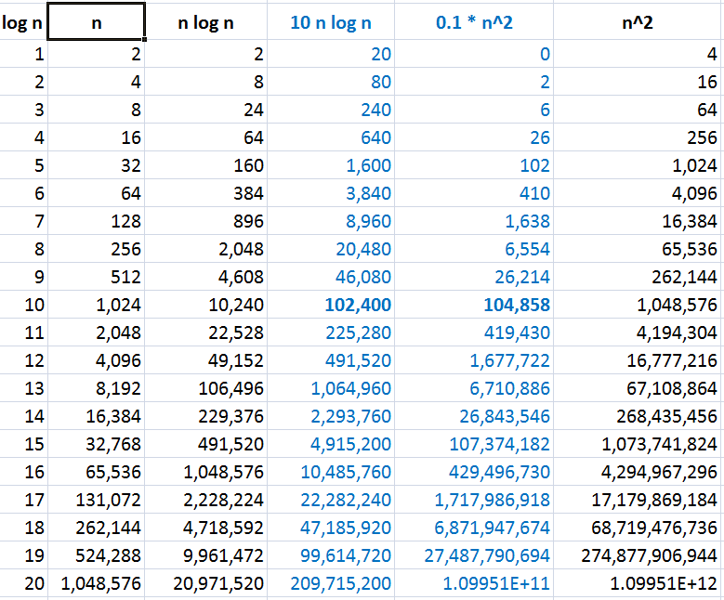
ADVANCED ALGORITHMS
BASICS OF COMPLEXITY
Order of Growth

Slide 13
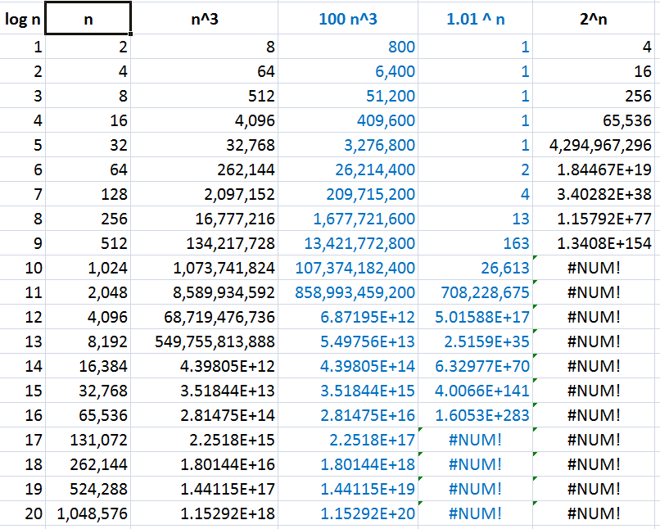
ADVANCED ALGORITHMS
BASICS OF COMPLEXITY
Order of Growth

Slide 14
ADVANCED ALGORITHMS
BASICS OF COMPLEXITY
What if the basic operation runs for 2¹⁰⁰ times?
Suppose,
An algorithm takes 2¹⁰⁰ operations.
Tower of Hanoi takes about 2¹⁰⁰ operations for 100 disks.
Each operation takes just one clock tick.
1 terahertz processor exists. (∵ 10¹² ≅ 2⁴⁰)
So, the algorithm takes 2¹⁰⁰ / 2⁴⁰ = 2⁶⁰ seconds.
≅ 2³⁵ years (∵ 1 year = 60*60*24*365 ≅ 2²⁵ seconds)
≅ 32 * 10⁹ years (∵ 10⁹ ≅ 2³⁰)
= 32 billion years
BTW, it’s estimated that the Earth formed about 4.5 billion years back and the big bang happened about 14 billion years back.
Algorithms that require an exponential number of operations are practical for solving only problems with very small input sizes.

Slide 15
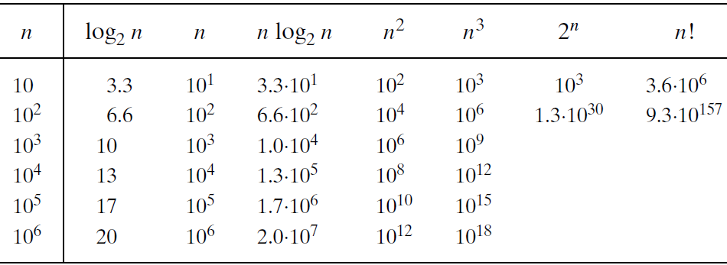
ADVANCED ALGORITHMS
BASICS OF COMPLEXITY
Orders of growth

Slide 16
ADVANCED ALGORITHMS
BASICS OF COMPLEXITY
Asymptotic Notations
“Big Oh” O(g(n)):
class of functions f(n) that grow no faster than g(n)
“Big Omega” Ω(g(n)):
class of functions f(n) that grow at least as fast as g(n)
“Big Theta” Θ(g(n)):
class of functions f(n) that grow at the same rate as g(n)
“Little oh” o(g(n)):
class of functions f(n) that grows slower than g(n)
“Little omega” ω(g(n):
class of functions f(n) that grows faster than g(n)

Slide 17
ADVANCED ALGORITHMS
BASICS OF COMPLEXITY
O(g(n): Big O Notation
For a given function g(n), we denote O(g(n)) as the set of functions:
O- notation gives an upper bound on a function, within a constant factor

Slide 18
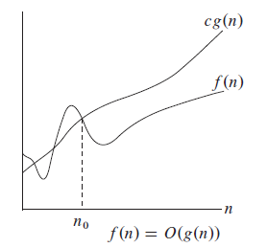
ADVANCED ALGORITHMS
BASICS OF COMPLEXITY
Asymptotic Notations
“Big Oh” O(g(n)):
A function f(n) is said to be in O(g(n)) if f(n) is bounded above by some constant multiple of g(n) for all large n.
f(n) ≤ cg(n) ∀ n ≥ n₀, c>0
denoted as f(n) ∈ O(g(n))

Slide 19
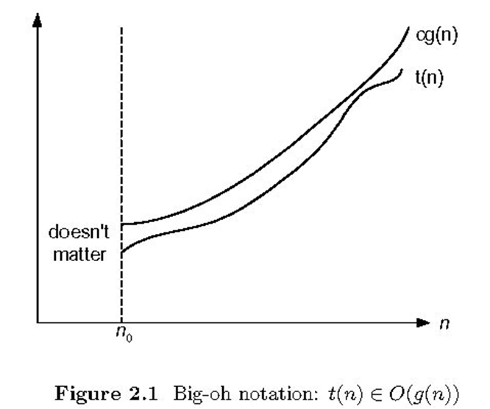
ADVANCED ALGORITHMS
BASICS OF COMPLEXITY
Asymptotic Notations
“Big Oh” O(g(n)):
t(n) ≤ cg(n) ∀ n ≥ n₀
Eg: 100n+5 ∈ O(n)
100n+5 ≤ 100n+5n (∀ n≥1)
100n+5 ≤ 105n ∀ n≥1 (∴ c=105, n₀=1)
100n+5 ≤ 100n+n (∀ n≥5) = 101n ∀ n≥5 (∴ c=101,n₀=5)
Eg: 100n²+5 ∈ O(n²)
Eg: n(n-1)/2 ∈ O(n²)

Slide 20

ADVANCED ALGORITHMS
BASICS OF COMPLEXITY
Ω(g(n): Big Omega Notation
For a given function g(n), we denote Ω (g(n)) as the set of functions:
Ω- notation gives a lower bound on a function, within a constant factor

Slide 21
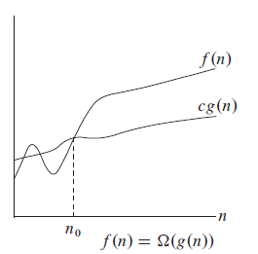
ADVANCED ALGORITHMS
BASICS OF COMPLEXITY
Asymptotic Notations
“Big Omega” Ω(g(n)):
A function f(n) is said to be in Ω(g(n)) if f(n) is bounded below by some constant multiple of g(n) for all large n.
f(n) ≥ cg(n) ≥ 0 ∀ n ≥ n₀
denoted by f(n) ∈ Ω(g(n))

Slide 22
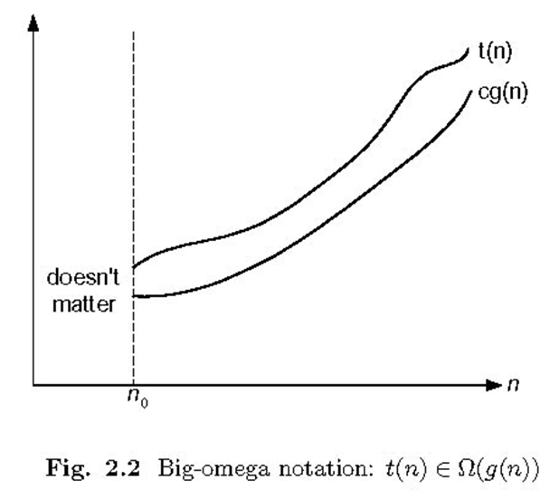
ADVANCED ALGORITHMS
BASICS OF COMPLEXITY
Asymptotic Notations
“Big Omega” Ω(g(n)):
t(n) ≥ cg(n) ∀ n ≥ n₀
Eg: 100n+5 ∈ Ω(n)
100n+5 ≥ 100n (∀ n≥0)
100n+5 ≥ 100n ∀ n≥0 (∴ c=100, n₀=0)
Eg: n(n-1)/2 ∈ Ω(n²)
Eg: n(n-1)/2 ∈ Ω(n)

Slide 23

ADVANCED ALGORITHMS
BASICS OF COMPLEXITY
Θ(g(n): Big Theta Notation
For a given function g(n), we denote Θ (g(n)) as the set of functions:
Θ- notation gives a upper and lower bound on a function, within a constant factor
Θ- notation gives a upper and lower bound on a function, within a constant factor

Slide 24
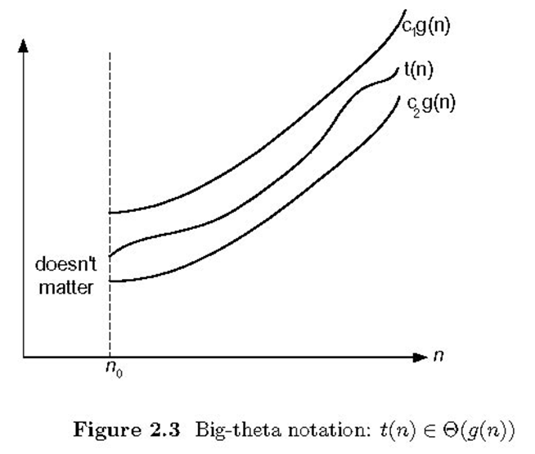
ADVANCED ALGORITHMS
BASICS OF COMPLEXITY
Asymptotic Notations
“Big Theta” Θ(g(n)):
A function f(n) is said to be in Θ(g(n)) if t(n) is bounded both above and below by some constant multiples of g(n) for all large n.
c₂g(n)≤ t(n) ≤ c₁g(n) ∀ n ≥ n₀
Denoted by t(n) ∈ Θ(g(n))

Slide 25
ADVANCED ALGORITHMS
BASICS OF COMPLEXITY
Asymptotic Notations
“Big Theta” Θ(g(n)):
c₂g(n)≤ t(n) ≤ c₁g(n) ∀ n ≥ n₀
Eg: n(n-1)/2 ∈ Θ(n²)
n(n-1)/2 = n²/2 - n/2 ≤ n²/2 ∀ n≥0
n(n-1)/2 = n²/2 - n/2 ≥ n²/2 - n²/4 = n²/4 ∀ n≥2
n²/4 ≤ n(n-1)/2 ≤ n²/2 ∀ n≥2
(∴ c₁=1/2, c₂=1/4, n₀=2)

Slide 26
ADVANCED ALGORITHMS
BASICS OF COMPLEXITY
t(n) ∈ O(g(n))
Nonnegative functions defined on the set of natural numbers
t(n): algorithm’s running time by counting basic operation
g(n): simple function to compare the count with.
O(g(n)) is the set of all functions with a smaller or same order of growth as g(n).
E.g.: 100n + 5 ∈ O(n)
∈ O(n²)
∉ O(log n)
n(n-1)/2 ∈ O(n²)
∈ O(n¹⁰)
∉ O(n)

Slide 27
ADVANCED ALGORITHMS
BASICS OF COMPLEXITY
Ω(g(n)) is the set of all functions with a larger or same order of growth as g(n).
E.g.: 100n + 5 ∈ Ω(n)
∉ Ω(n²)
∈ Ω(log n)
n(n-1)/2 ∈ Ω(n²)
∉ Ω(n¹⁰)
∈ Ω(n)
Θ(g(n)) is the set of all functions that have the same order of growth as g(n).
E.g.: n(n-1)/2 ∈ Θ(n²)
∉ Θ(n³)
∉ Θ(n logn)

Slide 28


ADVANCED ALGORITHMS
BASICS OF COMPLEXITY
o-notation
O-notation may or may not be asymptotically tight.
2n²= o(n²) upper bound that is asymptotically tight, but
2n= o(n²) is not.
o-notation denotes an upper bound that is not asymptotically tight.
We formally define o(g(n)) as the set:

Slide 29
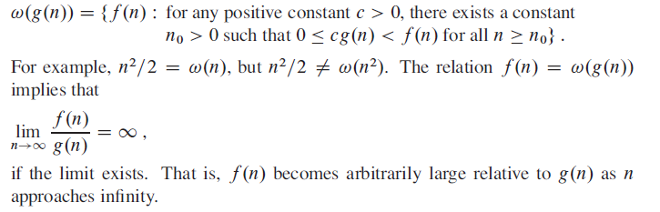
ADVANCED ALGORITHMS
BASICS OF COMPLEXITY
ω-notation
Ω-notation may or may not be asymptotically tight.
n²/2= ω (n²) upper bound that is asymptotically tight, but
n²/2 = ω(n) is not.
ω -notation denotes an upper bound that is not asymptotically tight.
We formally define ω(g(n)) as the set:

Slide 30
ADVANCED ALGORITHMS
BASICS OF COMPLEXITY
Asymptotic notation in equalities and inequalities
f(n)= O(n²) implies f(n) ∈ O(n²)
Similarly
2 n² + 3n +1 = 2 n² + Θ(n) implies
2 n² + 3n +1 = 2 n² + f(n)
Where f(n) is some function in the set Θ(n)
In this case f(n) = 3n + 1
If we are interested in the asymptotic behavior of T(n) there is no point in specifying all lower order terms is detail.
In some cases asymptotic notation appears on the LHS
2 n² + Θ(n) = Θ(n²) implies
2 n² + f(n) = Θ(n²) where f(n)= Θ(n)

Slide 31
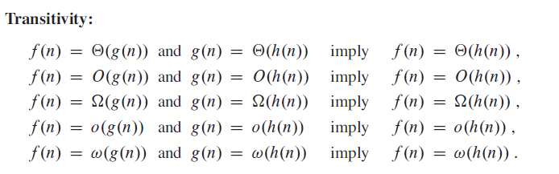
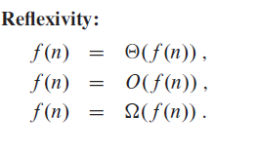
ADVANCED ALGORITHMS
BASICS OF COMPLEXITY
Comparing Functions

Slide 32
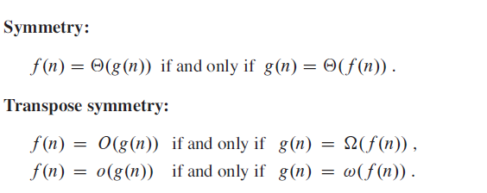
ADVANCED ALGORITHMS
BASICS OF COMPLEXITY
Comparing Functions

